Slide 1
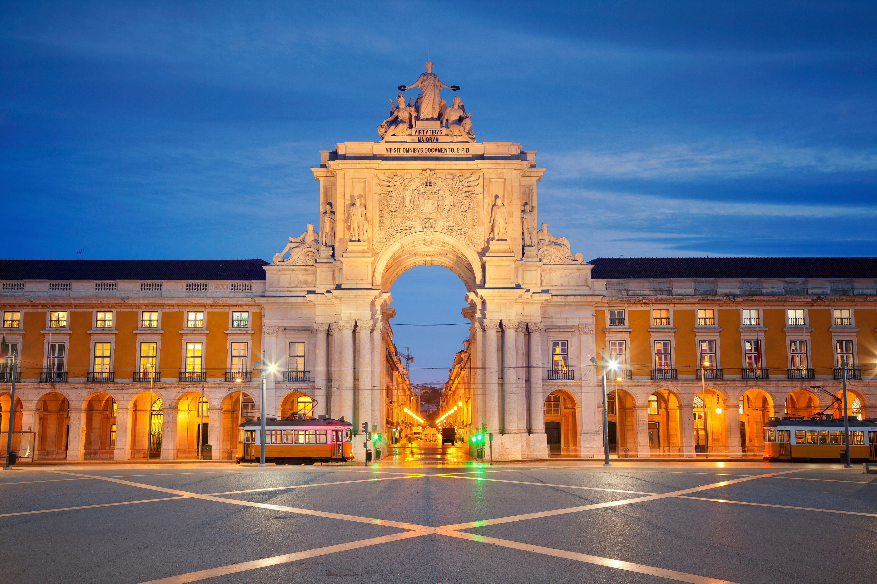

Post-Pandemic
Tourism
Trends
in Portugal
Data Science for Marketing
Bernardo Abreu – 20230062
Fernanda Trindade – 20230070
Muhammet Emin Imir – 20231378
Tausif Ahmad – 20231030

Slide 2
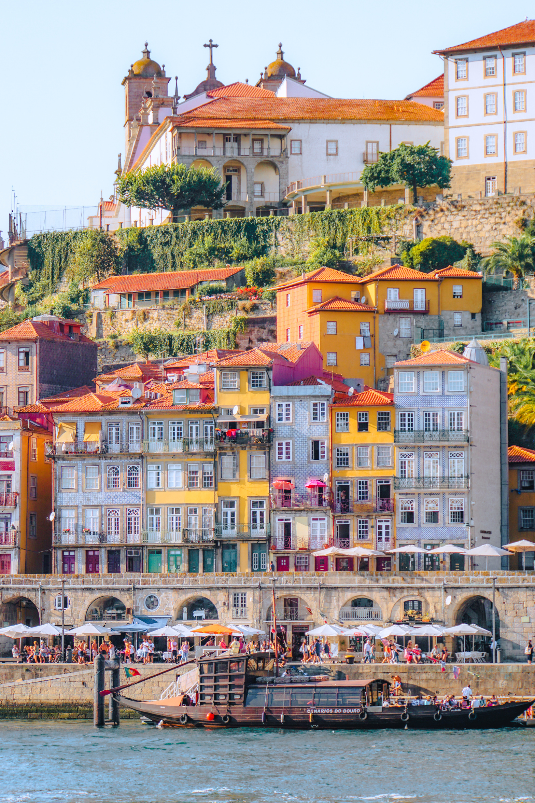
INDEX
Introduction
NTBO Briefing
Business Objectives & Results
Methodology
Analysis Results
Marketing Recommendations
1

Slide 3

Introduction
The COVID-19 pandemic severely impacted the tourism sector, one of the world's major economic sectors. In 2020, tourism's export revenues were expected to decrease by $910 billion to $1.2 trillion, potentially reducing global GDP by up to 2.8%. ¹
The COVID-19 pandemic significantly impacted Portugal's tourism industry, a key contributor to its GDP.
¹ Tourism and COVID-19 – unprecedented economic impacts | UNWTO. https://www.unwto.org/tourism-and-covid-19-unprecedented-economic-impacts
2

Slide 4
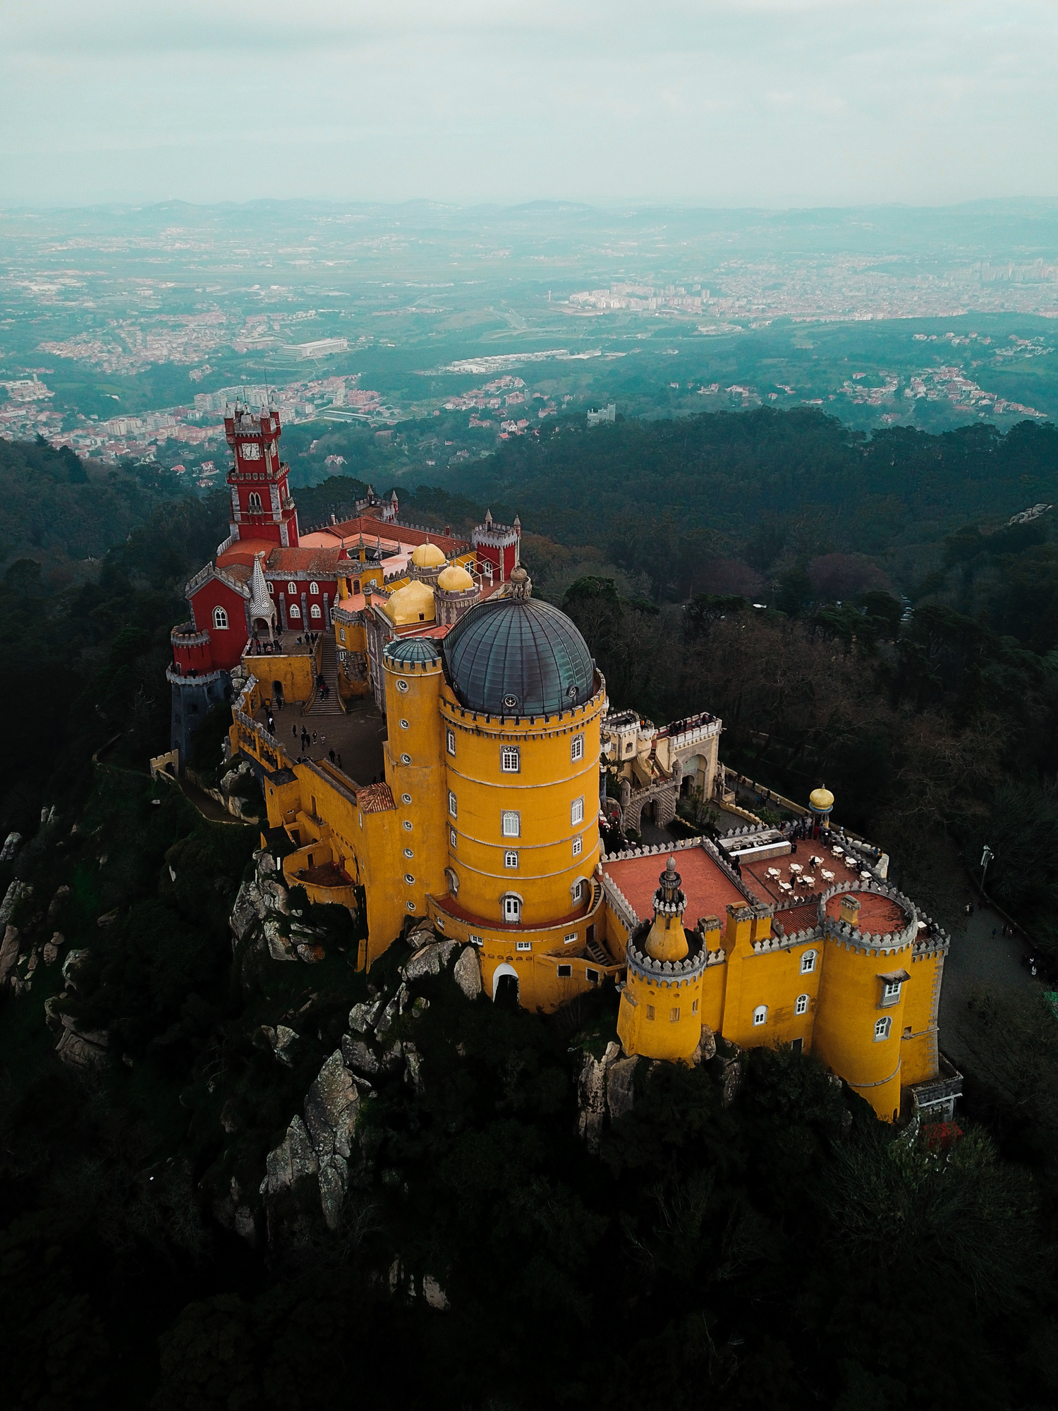

NTBO Briefing
The National Tourism Board Organizations of Portugal (NTBO) are interested in analyzing user-generated content, particularly the reviews on Tripadvisor, to gain insights into visitor trends and determine if these trends have been influenced by the pandemic.
Additionally, it was proposed to identify and describe the visiting patterns at Portuguese attractions and compare them with those of Portugal's primary tourism competitors.
These analyses were conducted using the dataset of the Top 100 Attractions in Europe from 2019 to 2021, provided by the NTBO.
3

Slide 5
Business Objectives & Results
Results
Objectives
Optimizing Resource Allocation
Characterization of Visitor Patterns
Analysis of the Impact of COVID-19
Competitor Analysis
Visitor Segmentation
Pattern Analysis
Visitor Experience Enhancement
Competitive Differentiation
Targeted Marketing Campaigns
4

Slide 6

Methodology
Top 100 Attractions in Europe
2019 – 2021
CRISP-DM
Business Understanding
Data Understanding
Data Preparation
Market Basket Analysis
RFM
Model
Modeling
Evaluation
Business Outputs
5

Slide 7

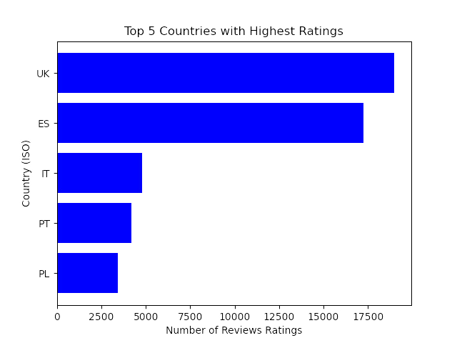


Competitiion
VS
6

Slide 8
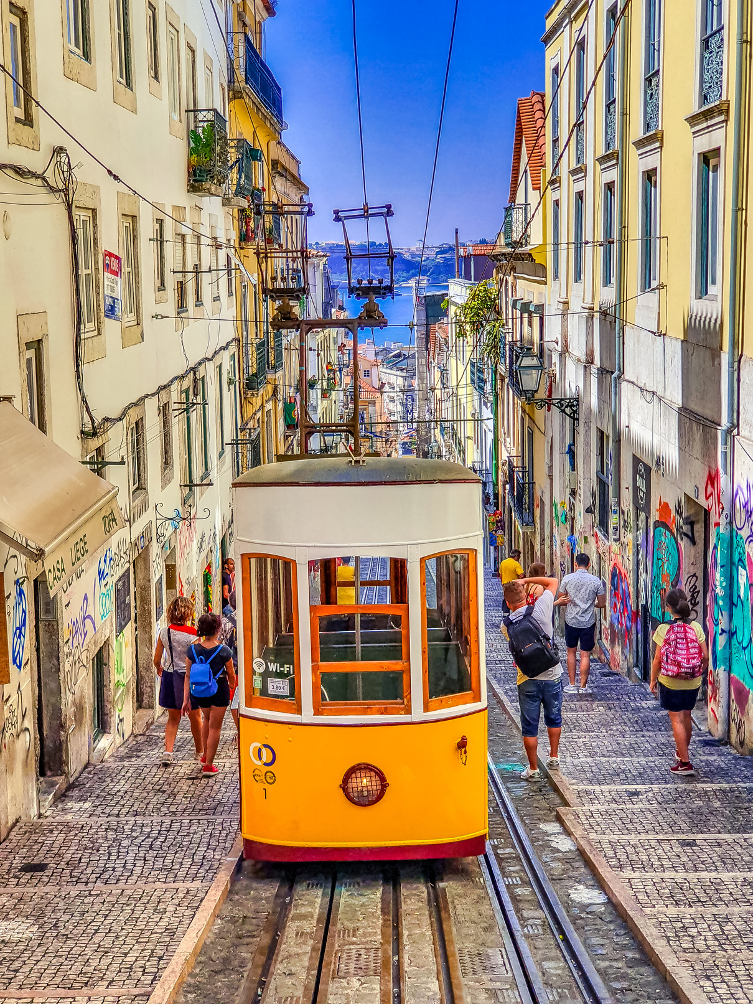
Market Basket
Analysis
Tourist Travel Patterns in Spain and Portugal
Link Among Spanish Landmarks: Visitors to Real Alcazar de Sevilla, Casa Milà - La Pedrera, and the Palace of Catalan Music likely to also visit Casa Batlló in Barcelona
Tourist Duos in Portugal: About 0.46% of tourists visit both Torre de Belém and Mosteiro dos Jerónimos in Lisbon
Cross-Country Visit Patterns: Tourists at Mosteiro dos Jerónimos often visit Casa Milà - La Pedrera and Parc Guell in Barcelona
Sequential Visits: Common travel sequence involves Mosteiro dos Jerónimos and the Park and National Palace of Pena in Lisbon, followed by Parc Guell in Barcelona
Insights for Trip Planning: Analysis highlights popular landmarks visited in sequence, aiding in trip planning
7
7

Slide 9

RFM
Analysis
Targeting High-Value Tourists
High RFM Scores: Tourists with high RFM scores are more engaged and interested, making them key targets for marketing
Low RFM Scores: Need alternative strategies to boost their interaction with attractions
"144" Visitor Segment Analysis:
Low average recency, suggesting new or highly active visitors
High frequency and spending, indicating strong engagement and expenditure
Tourist Attractions and "144" Segment:
Attractions like Don Luis I Bridge, Park and National Palace of Pena, and Cais da Ribeira show minimal "144" segment presence
These attractions represent untapped opportunities; even modest visits from "144" segment could indicate significant interest
+
–
8

Slide 10
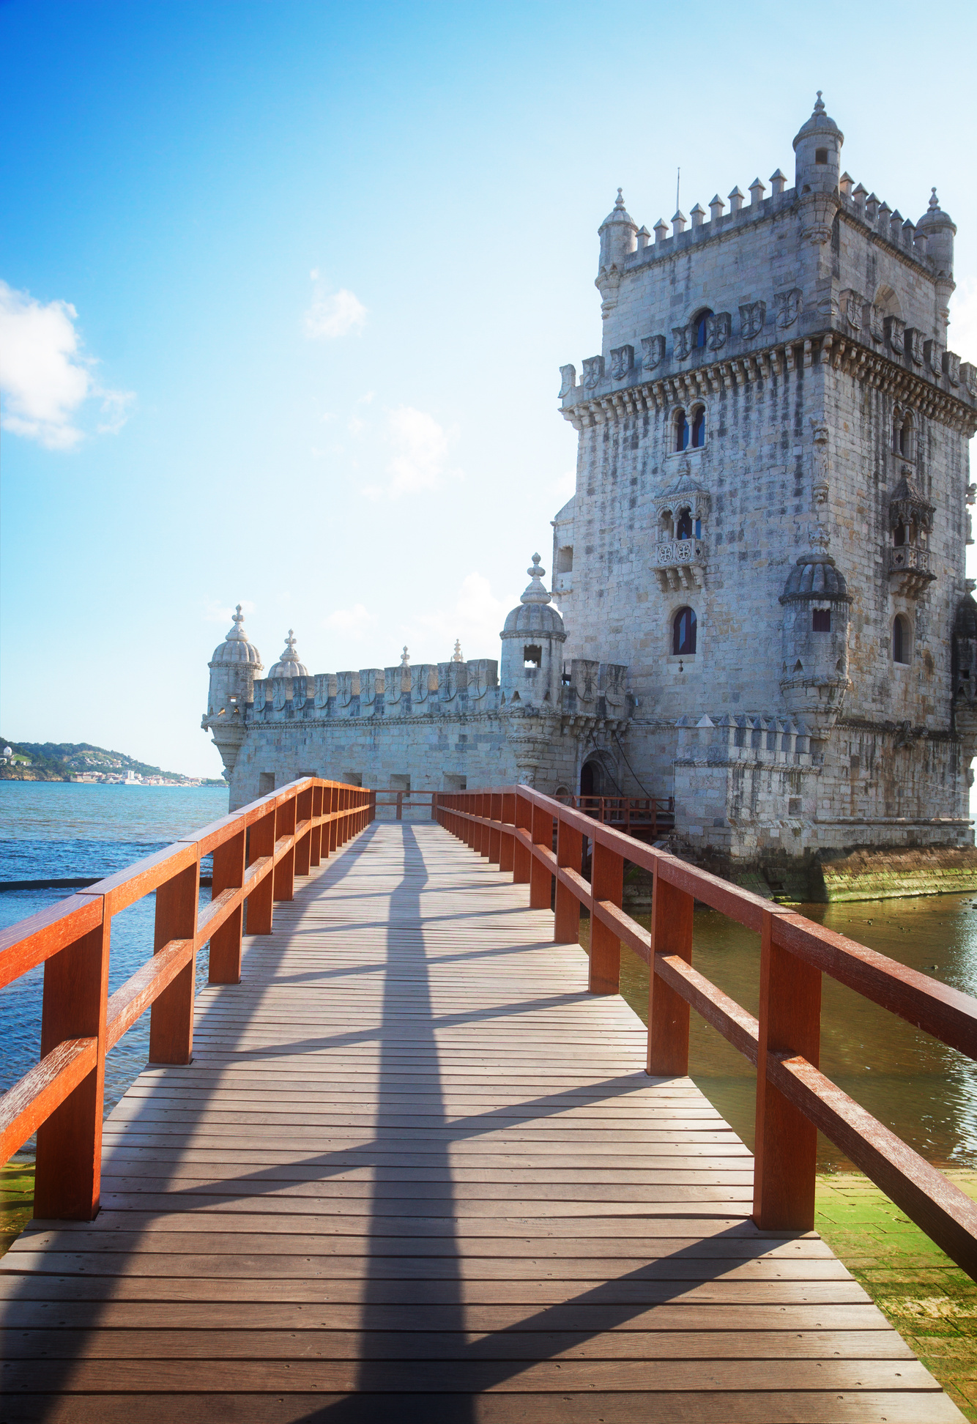
Marketing recommendations
Collaborative Marketing Campaigns: Implement joint marketing for attractions often visited together, like Mosteiro dos Jerónimos and nearby Lisbon sites. Offer package deals at competitive prices to outshine competitors in Portugal's tourism sector, including the UK, Spain, and Italy
Segment-Specific Engagement Strategies: Offer premium experiences or loyalty programs to high-value tourists (high RFM scores), and use discounts or special events to engage those with lower scores
9

Slide 11
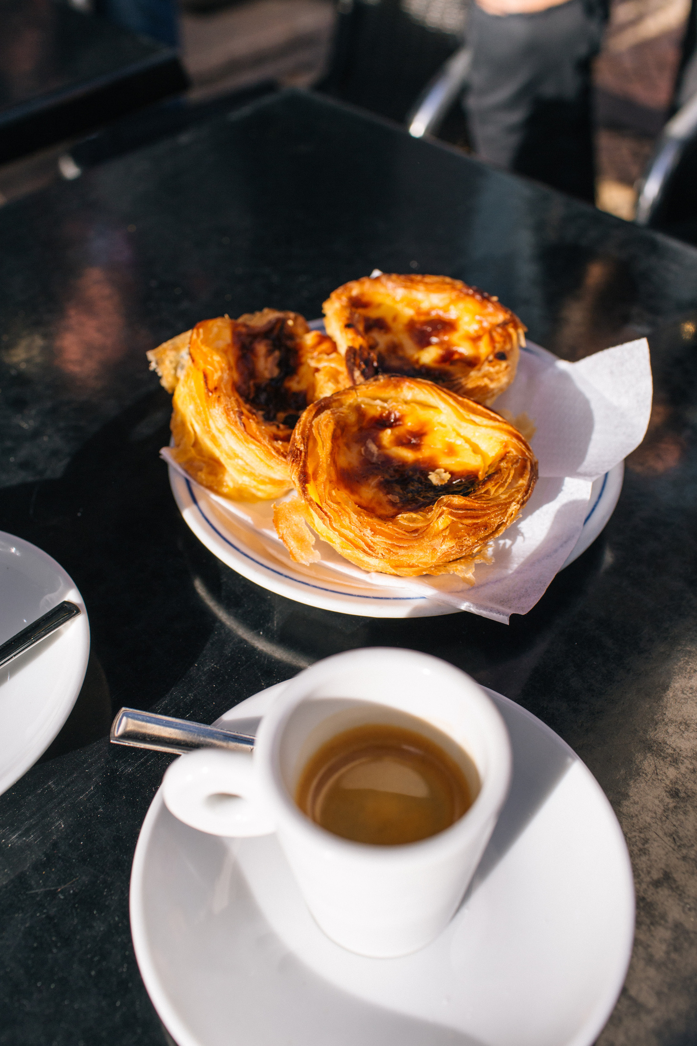
Marketing recommendations
Boosting Lesser-Visited Attractions: Create campaigns to boost lesser-visited attractions by using storytelling, emphasizing their unique features, or pairing them with popular attractions
Digital Marketing Engagement: Utilizing digital marketing and social media to target distinct tourist segments, guided by data insights for creating content aligned with their preferences. Leveraging Tripadvisor reviews for a richer data foundation, the NTBO can enhance engagement on this platform, enabling adaptation to fast-changing tourist behavior.
10

Slide 12
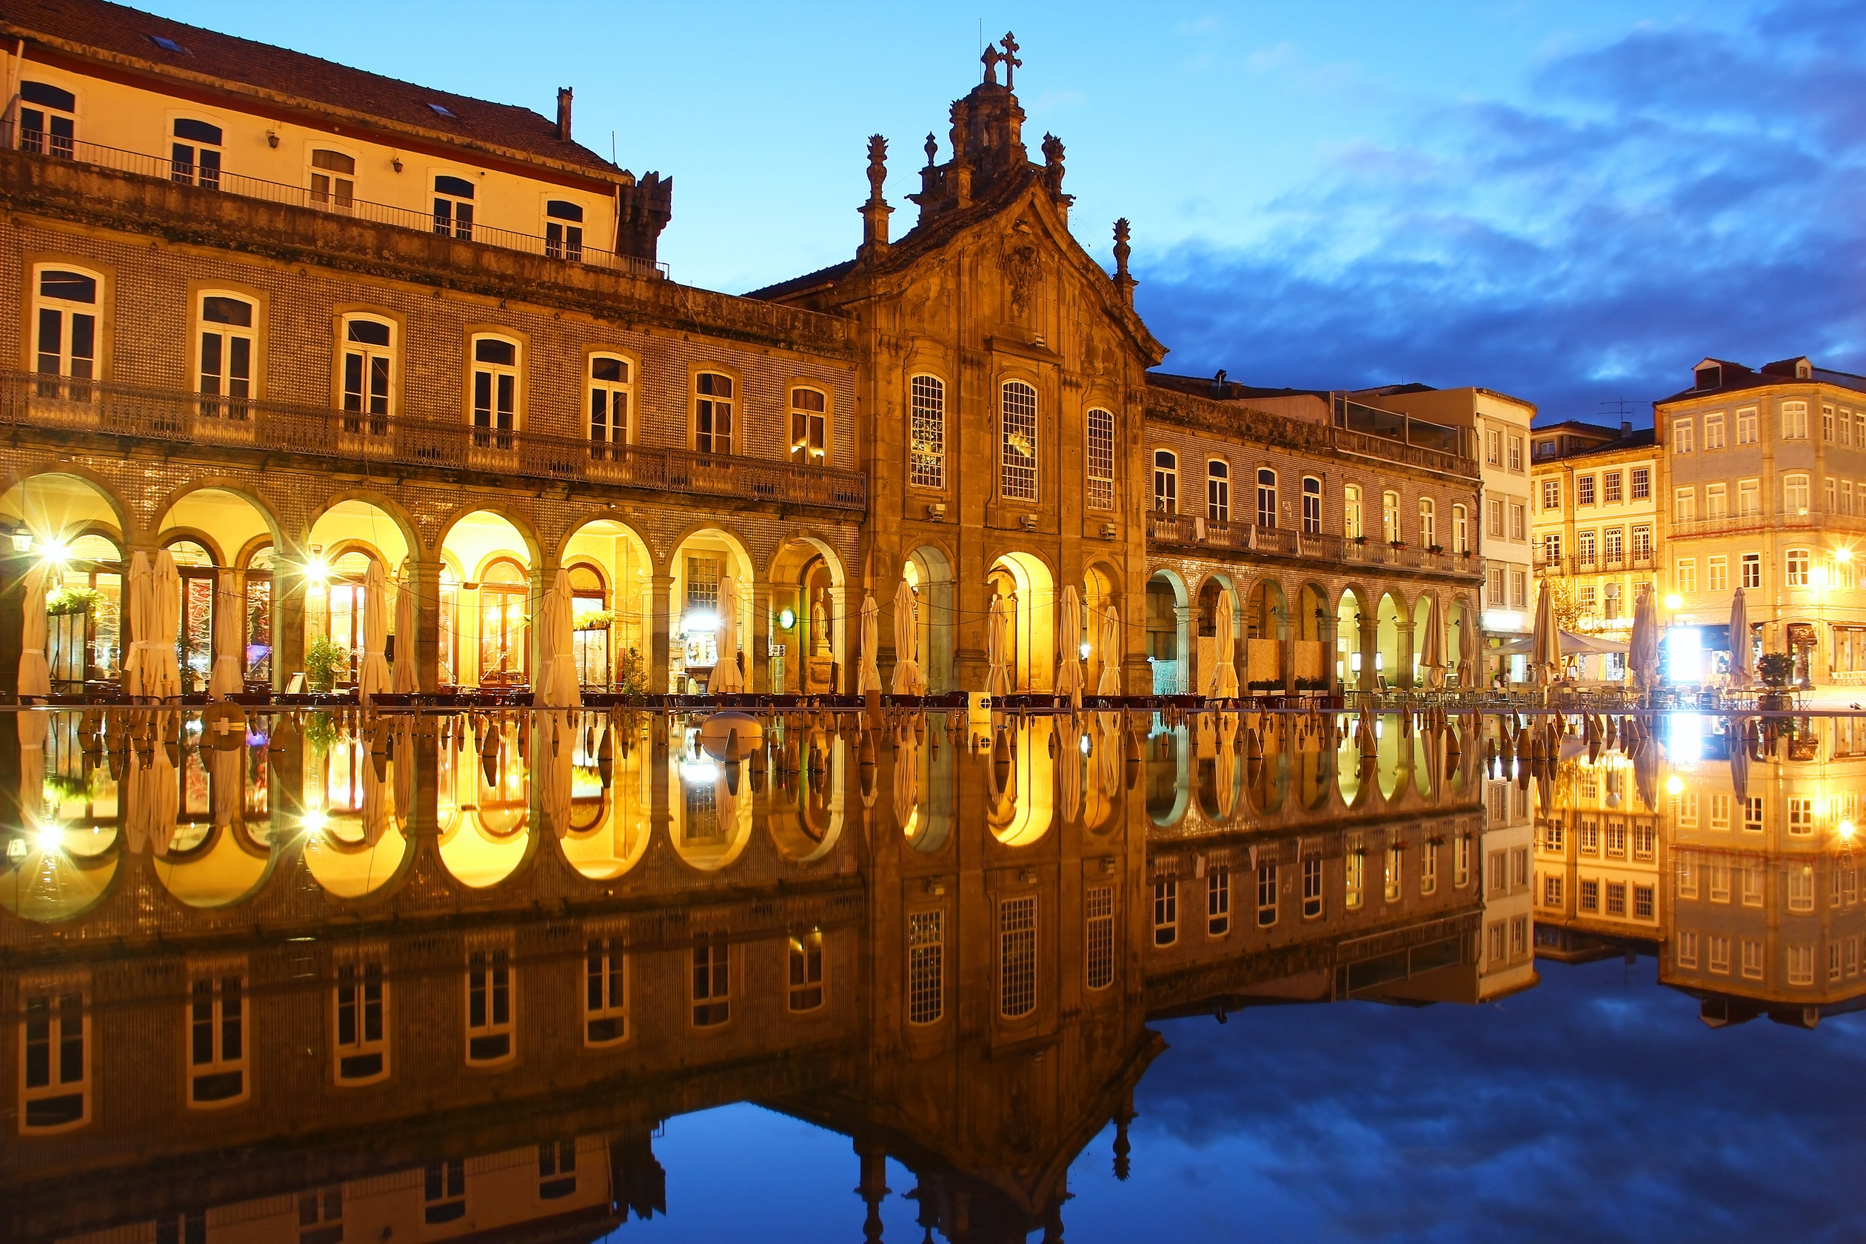
Thank You
Data Science for Marketing
Bernardo Abreu – 20230062
Fernanda Trindade – 20230070
Muhammet Emin Imir – 20231378
Tausif Ahmad – 20231030

